Slide 1

C1382 · ONE DAY
Claude Cowork Masterclass
Eight practical automations for Excel, research, reporting and scheduled finance tasks
C1382 • v2.1
1

Slide 2
COURSE PROMISE
Leave with eight tasks you can reuse
UPDATE
RESEARCH
CREATE
EXTRACT
latest finance data
current AI news
Excel and PowerPoint
invoice details
EXPLAIN
MONITOR
DRAFT
SCHEDULE
budget variances
cash flow
management email
weekly briefing
C1382 • v2.1 • Task automation with Claude Cowork
2

Slide 3
HOW YOU'LL LEARN
Watch it · try it · check it · reuse it
1
2
3
4
See a finance scenario
Use a ready prompt
Inspect the output
Save the skill
C1382 • v2.1 • Task automation with Claude Cowork
3

Slide 4
SIMPLE RULE
Use one dedicated folder per task
READ
mock-data and task brief
WORK
working copy only
SAVE
finished files in outputs
C1382 • v2.1 • Task automation with Claude Cowork
4

Slide 5
PROMPT RECIPE
Five lines make a useful Cowork brief
OUTCOME
What should be finished?
INPUTS
Which files or sources?
OUTPUT
What filename and format?
CHECK
How do we know it is right?
STOP
What needs human approval?
C1382 • v2.1 • Task automation with Claude Cowork
5

Slide 6
COURSE MAP
Three topics · eight practical labs
TOPIC 1
TOPIC 2
TOPIC 3
Set up and refresh
Labs 1–2
Research and present
Labs 3–4
Monitor and deliver
Labs 5–8
C1382 • v2.1 • Task automation with Claude Cowork
6

Slide 7
TOPIC 01
Set Up and Refresh
Build a reusable workspace and keep Excel current
C1382 • v2.1
7

Slide 8
USE CASE 01 · SET UP ONCE
Create a Cowork Project
A reusable workspace for every finance task
C1382 • v2.1
8

Slide 9
USE CASE 01
From repetitive work to a finished outcome
BEFORE
AFTER
Files and instructions live in different places
A reusable workspace for every finance task
C1382 • v2.1 • Task automation with Claude Cowork
9

Slide 10
USE CASE 01
What Cowork receives
FILE
BRIEF
CHECK
Project brief
Close checklist
Dedicated lab folder
C1382 • v2.1 • Task automation with Claude Cowork
10

Slide 11
USE CASE 01
What Cowork does
1
2
3
Create project
Connect one folder
Add finance skill
C1382 • v2.1 • Task automation with Claude Cowork
11

Slide 12
USE CASE 01
Build the request in five clear parts
OUTCOME
A reusable workspace for every finance task
INPUT
Project brief, Close checklist
ACTION
Give Cowork one project, one folder and clear rules
CHECK
File map lists every source; originals stay unchanged
STOP
Pause before sending, scheduling or publishing
C1382 • v2.1 • Task automation with Claude Cowork
12

Slide 13
USE CASE 01
The task needs three simple capabilities
FIND & READ
BUILD
REVIEW OR DELIVER
Project brief
A reusable workspace for every finance task
File map lists every source; originals stay unchanged
Cowork Projects
Local folder access
Project instructions
C1382 • v2.1 • Task automation with Claude Cowork
13

Slide 14
USE CASE 01
Preview the finished output
FINISHED
A reusable workspace for every finance task
File map lists every source; originals stay unchanged
C1382 • v2.1 • Task automation with Claude Cowork
14

Slide 15
USE CASE 01
One human check before you use it
File map lists every source; originals stay unchanged
CHECK
If this does not match, correct the output and run the check again.
C1382 • v2.1 • Task automation with Claude Cowork
15

Slide 16
USE CASE 01
When this automation helps
WHO
WHEN
Finance analyst
At the start of a recurring task
C1382 • v2.1 • Task automation with Claude Cowork
16

Slide 17
USE CASE 01
What good looks like
1
2
3
One clear task folder
Originals remain unchanged
Project rules persist
C1382 • v2.1 • Task automation with Claude Cowork
17

Slide 18
USE CASE 01
Try a useful variation
PERIOD
AUDIENCE
OUTPUT
Quarter-end close
New team member
Policy review
C1382 • v2.1 • Task automation with Claude Cowork
18

Slide 19
LAB 01
Finish line
YOU ARE DONE WHEN
File map lists every source; originals stay unchanged
Save the skill for the next reporting period.
C1382 • v2.1 • Task automation with Claude Cowork
19

Slide 20

USE CASE 02 · LATEST DATA
Refresh an Excel Dashboard
Current KPIs and charts in one Excel file
C1382 • v2.1
20

Slide 21
USE CASE 02
From repetitive work to a finished outcome
BEFORE
AFTER
The dashboard shows last month’s figures
Current KPIs and charts in one Excel file
C1382 • v2.1 • Task automation with Claude Cowork
21

Slide 22
USE CASE 02
What Cowork receives
FILE
BRIEF
CHECK
Three dated CSV files
Dashboard template
Expected KPI check
C1382 • v2.1 • Task automation with Claude Cowork
22

Slide 23
USE CASE 02
What Cowork does
1
2
3
Find latest file
Update Data sheet
Refresh charts
C1382 • v2.1 • Task automation with Claude Cowork
23

Slide 24
USE CASE 02
Build the request in five clear parts
OUTCOME
Current KPIs and charts in one Excel file
INPUT
Three dated CSV files, Dashboard template
ACTION
Find the newest dated file and refresh the workbook
CHECK
September: revenue S$128k, expenses S$89.5k, net S$38.5k
STOP
Pause before sending, scheduling or publishing
C1382 • v2.1 • Task automation with Claude Cowork
24

Slide 25
USE CASE 02
The task needs three simple capabilities
FIND & READ
BUILD
REVIEW OR DELIVER
Three dated CSV files
Current KPIs and charts in one Excel file
September: revenue S$128k, expenses S$89.5k, net S$38.5k
Cowork files
Spreadsheet skill
Microsoft Excel
C1382 • v2.1 • Task automation with Claude Cowork
25

Slide 26
USE CASE 02
Preview the finished output
FINISHED
Current KPIs and charts in one Excel file
September: revenue S$128k, expenses S$89.5k, net S$38.5k
C1382 • v2.1 • Task automation with Claude Cowork
26

Slide 27
USE CASE 02
One human check before you use it
September: revenue S$128k, expenses S$89.5k, net S$38.5k
CHECK
If this does not match, correct the output and run the check again.
C1382 • v2.1 • Task automation with Claude Cowork
27

Slide 28
USE CASE 02
When this automation helps
WHO
WHEN
Reporting analyst
When a new month file arrives
C1382 • v2.1 • Task automation with Claude Cowork
28

Slide 29
USE CASE 02
What good looks like
1
2
3
Newest dated source chosen
KPIs match control totals
Charts show the new period
C1382 • v2.1 • Task automation with Claude Cowork
29

Slide 30
USE CASE 02
Try a useful variation
PERIOD
AUDIENCE
OUTPUT
Weekly cash data
Department view
Different KPI target
C1382 • v2.1 • Task automation with Claude Cowork
30

Slide 31
LAB 02
Finish line
YOU ARE DONE WHEN
September: revenue S$128k, expenses S$89.5k, net S$38.5k
Save the skill for the next reporting period.
C1382 • v2.1 • Task automation with Claude Cowork
31

Slide 32
TOPIC 01 RECAP
Set Up and Refresh
USE CASE 01
USE CASE 02
A reusable workspace for every finance task
Current KPIs and charts in one Excel file
C1382 • v2.1 • Task automation with Claude Cowork
32

Slide 33

TOPIC 02
Research and Present
Turn live information and finance data into clear outputs
C1382 • v2.1
33

Slide 34
USE CASE 03 · LIVE RESEARCH
Research AI-in-Finance News
A structured Excel research tracker
C1382 • v2.1
34

Slide 35
USE CASE 03
From repetitive work to a finished outcome
BEFORE
AFTER
Interesting news is scattered across many websites
A structured Excel research tracker
C1382 • v2.1 • Task automation with Claude Cowork
35

Slide 36
USE CASE 03
What Cowork receives
FILE
BRIEF
CHECK
Research brief
Excel tracker template
Live web sources
C1382 • v2.1 • Task automation with Claude Cowork
36

Slide 37
USE CASE 03
What Cowork does
1
2
3
Search recent sources
Check dates and links
Write to Excel
C1382 • v2.1 • Task automation with Claude Cowork
37

Slide 38
USE CASE 03
Build the request in five clear parts
OUTCOME
A structured Excel research tracker
INPUT
Research brief, Excel tracker template
ACTION
Find six recent, credible developments and cite each source
CHECK
Six direct links open; every date and summary is sourced
STOP
Pause before sending, scheduling or publishing
C1382 • v2.1 • Task automation with Claude Cowork
38

Slide 39
USE CASE 03
The task needs three simple capabilities
FIND & READ
BUILD
REVIEW OR DELIVER
Research brief
A structured Excel research tracker
Six direct links open; every date and summary is sourced
Cowork web search
Web fetch
Spreadsheet skill
C1382 • v2.1 • Task automation with Claude Cowork
39

Slide 40
USE CASE 03
Illustrative research tracker preview
DATE
SOURCE
DEVELOPMENT
LINK
LIVE CHECK
LIVE CHECK
MAS
Responsible AI
mas.gov.sg
Open each link
Confirm publish date
Keep only recent items
Summarise the source
LIVE CHECK
BIS
Cross-border AI
bis.org
LIVE CHECK
IMF
AI readiness
imf.org
LIVE CHECK
ECB
AI in banking
ecb.europa.eu
LIVE CHECK
Bank of England
AI survey
bankofengland.co.uk
LIVE CHECK
OECD
AI policy
oecd.org
C1382 • v2.1 • Task automation with Claude Cowork
40

Slide 41
USE CASE 03
One human check before you use it
Six direct links open; every date and summary is sourced
CHECK
If this does not match, correct the output and run the check again.
C1382 • v2.1 • Task automation with Claude Cowork
41

Slide 42
USE CASE 03
When this automation helps
WHO
WHEN
Finance strategy team
Before a market or risk briefing
C1382 • v2.1 • Task automation with Claude Cowork
42

Slide 43
USE CASE 03
What good looks like
1
2
3
Six recent developments
Direct sources open
Summary fits the brief
C1382 • v2.1 • Task automation with Claude Cowork
43

Slide 44
USE CASE 03
Try a useful variation
PERIOD
AUDIENCE
OUTPUT
Regulation news
Competitor update
Risk-only tracker
C1382 • v2.1 • Task automation with Claude Cowork
44

Slide 45
LAB 03
Finish line
YOU ARE DONE WHEN
Six direct links open; every date and summary is sourced
Save the skill for the next reporting period.
C1382 • v2.1 • Task automation with Claude Cowork
45

Slide 46
USE CASE 04 · MANAGEMENT STORY
Turn Finance Data into Slides
Clear charts, messages and next actions
C1382 • v2.1
46

Slide 47
USE CASE 04
From repetitive work to a finished outcome
BEFORE
AFTER
Leaders receive a dense workbook
Clear charts, messages and next actions
C1382 • v2.1 • Task automation with Claude Cowork
47

Slide 48
USE CASE 04
What Cowork receives
FILE
BRIEF
CHECK
Quarterly workbook
Manager brief
Brand guide
C1382 • v2.1 • Task automation with Claude Cowork
48

Slide 49
USE CASE 04
What Cowork does
1
2
3
Read the brief
Choose the story
Build editable slides
C1382 • v2.1 • Task automation with Claude Cowork
49

Slide 50
USE CASE 04
Build the request in five clear parts
OUTCOME
Clear charts, messages and next actions
INPUT
Quarterly workbook, Manager brief
ACTION
Turn the numbers into a five-slide update
CHECK
Five slides; Q3 revenue S$378k and net S$108.5k match Excel
STOP
Pause before sending, scheduling or publishing
C1382 • v2.1 • Task automation with Claude Cowork
50

Slide 51
USE CASE 04
The task needs three simple capabilities
FIND & READ
BUILD
REVIEW OR DELIVER
Quarterly workbook
Clear charts, messages and next actions
Five slides; Q3 revenue S$378k and net S$108.5k match Excel
Cowork files
Spreadsheet skill
PowerPoint skill
C1382 • v2.1 • Task automation with Claude Cowork
51

Slide 52
USE CASE 04
Preview the finished output
FINISHED
Clear charts, messages and next actions
Five slides; Q3 revenue S$378k and net S$108.5k match Excel
C1382 • v2.1 • Task automation with Claude Cowork
52

Slide 53
USE CASE 04
One human check before you use it
Five slides; Q3 revenue S$378k and net S$108.5k match Excel
CHECK
If this does not match, correct the output and run the check again.
C1382 • v2.1 • Task automation with Claude Cowork
53

Slide 54
USE CASE 04
When this automation helps
WHO
WHEN
Finance business partner
Before a management meeting
C1382 • v2.1 • Task automation with Claude Cowork
54

Slide 55
USE CASE 04
What good looks like
1
2
3
Five-slide story
Figures match Excel
Actions are explicit
C1382 • v2.1 • Task automation with Claude Cowork
55

Slide 56
USE CASE 04
Try a useful variation
PERIOD
AUDIENCE
OUTPUT
Board audience
Investor update
One-page summary
C1382 • v2.1 • Task automation with Claude Cowork
56

Slide 57
LAB 04
Finish line
YOU ARE DONE WHEN
Five slides; Q3 revenue S$378k and net S$108.5k match Excel
Save the skill for the next reporting period.
C1382 • v2.1 • Task automation with Claude Cowork
57

Slide 58
TOPIC 02 RECAP
Research and Present
USE CASE 03
USE CASE 04
A structured Excel research tracker
Clear charts, messages and next actions
C1382 • v2.1 • Task automation with Claude Cowork
58

Slide 59
TOPIC 03
Monitor and Deliver
Extract, explain, monitor and deliver routine finance work
C1382 • v2.1
59

Slide 60
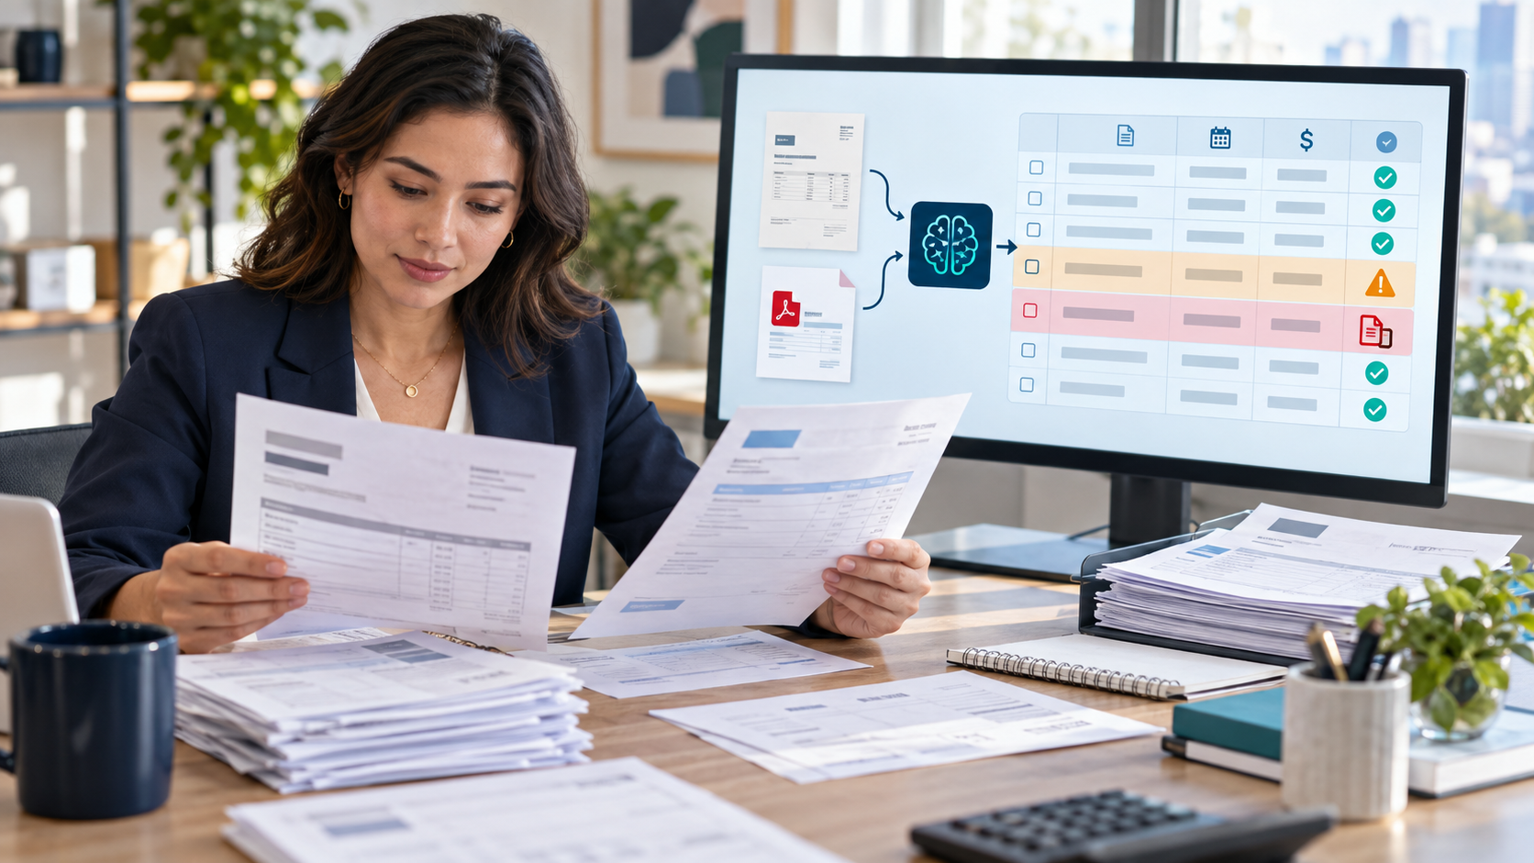
USE CASE 05 · DOCUMENT TO TABLE
Build an AP Tracker from Invoices
A tidy AP tracker ready for review
C1382 • v2.1
60

Slide 61
USE CASE 05
From repetitive work to a finished outcome
BEFORE
AFTER
Invoice details are copied one file at a time
A tidy AP tracker ready for review
C1382 • v2.1 • Task automation with Claude Cowork
61

Slide 62
USE CASE 05
What Cowork receives
FILE
BRIEF
CHECK
Five mock invoice PDFs
AP tracker template
Review rules
C1382 • v2.1 • Task automation with Claude Cowork
62

Slide 63
USE CASE 05
What Cowork does
1
2
3
Read invoices
Extract fields
Flag exceptions
C1382 • v2.1 • Task automation with Claude Cowork
63

Slide 64
USE CASE 05
Build the request in five clear parts
OUTCOME
A tidy AP tracker ready for review
INPUT
Five mock invoice PDFs, AP tracker template
ACTION
Extract five invoices and flag anything uncertain
CHECK
Five rows; duplicate INV-204 and missing PO are visible
STOP
Pause before sending, scheduling or publishing
C1382 • v2.1 • Task automation with Claude Cowork
64

Slide 65
USE CASE 05
The task needs three simple capabilities
FIND & READ
BUILD
REVIEW OR DELIVER
Five mock invoice PDFs
A tidy AP tracker ready for review
Five rows; duplicate INV-204 and missing PO are visible
Document reading
PDF skill
Spreadsheet skill
C1382 • v2.1 • Task automation with Claude Cowork
65

Slide 66
USE CASE 05
Preview the finished output
INVOICE
SUPPLIER
TOTAL
STATUS
EXCEPTIONS
INV-201
Northstar
S$1,250
READY
Duplicate retained for review
Missing PO remains unresolved
INV-202
Greenfield
S$2,180
READY
INV-203
Metro
S$860
READY
INV-204
Northstar
S$1,250
DUPLICATE
INV-205
Bluewave
S$3,400
MISSING PO
C1382 • v2.1 • Task automation with Claude Cowork
66

Slide 67
USE CASE 05
One human check before you use it
Five rows; duplicate INV-204 and missing PO are visible
CHECK
If this does not match, correct the output and run the check again.
C1382 • v2.1 • Task automation with Claude Cowork
67

Slide 68
USE CASE 05
When this automation helps
WHO
WHEN
Accounts payable team
When invoice batches arrive
C1382 • v2.1 • Task automation with Claude Cowork
68

Slide 69
USE CASE 05
What good looks like
1
2
3
All five invoices captured
Duplicate remains visible
Missing PO is flagged
C1382 • v2.1 • Task automation with Claude Cowork
69

Slide 70
USE CASE 05
Try a useful variation
PERIOD
AUDIENCE
OUTPUT
Expense receipts
Purchase orders
Vendor statements
C1382 • v2.1 • Task automation with Claude Cowork
70

Slide 71
LAB 05
Finish line
YOU ARE DONE WHEN
Five rows; duplicate INV-204 and missing PO are visible
Save the skill for the next reporting period.
C1382 • v2.1 • Task automation with Claude Cowork
71

Slide 72
USE CASE 06 · NUMBERS TO WORDS
Write Budget Variance Commentary
A reviewed workbook and one-page commentary
C1382 • v2.1
72

Slide 73
USE CASE 06
From repetitive work to a finished outcome
BEFORE
AFTER
Managers see variances but not the story
A reviewed workbook and one-page commentary
C1382 • v2.1 • Task automation with Claude Cowork
73

Slide 74
USE CASE 06
What Cowork receives
FILE
BRIEF
CHECK
Budget vs actual
Department notes
Materiality rule
C1382 • v2.1 • Task automation with Claude Cowork
74

Slide 75
USE CASE 06
What Cowork does
1
2
3
Calculate variance
Highlight material items
Draft commentary
C1382 • v2.1 • Task automation with Claude Cowork
75

Slide 76
USE CASE 06
Build the request in five clear parts
OUTCOME
A reviewed workbook and one-page commentary
INPUT
Budget vs actual, Department notes
ACTION
Calculate material variances and explain them simply
CHECK
Each comment links to a line item or is marked as a question
STOP
Pause before sending, scheduling or publishing
C1382 • v2.1 • Task automation with Claude Cowork
76

Slide 77
USE CASE 06
The task needs three simple capabilities
FIND & READ
BUILD
REVIEW OR DELIVER
Budget vs actual
A reviewed workbook and one-page commentary
Each comment links to a line item or is marked as a question
Cowork files
Spreadsheet skill
Document skill
C1382 • v2.1 • Task automation with Claude Cowork
77

Slide 78
USE CASE 06
Preview the finished output
COMMENTARY
Marketing +S$8k: campaign timing.
Travel +S$9k: client visits.
Contractors −S$4k: delayed onboarding.
C1382 • v2.1 • Task automation with Claude Cowork
78

Slide 79
USE CASE 06
One human check before you use it
Each comment links to a line item or is marked as a question
CHECK
If this does not match, correct the output and run the check again.
C1382 • v2.1 • Task automation with Claude Cowork
79

Slide 80
USE CASE 06
When this automation helps
WHO
WHEN
Cost-centre owner
During the monthly review
C1382 • v2.1 • Task automation with Claude Cowork
80

Slide 81
USE CASE 06
What good looks like
1
2
3
Material items highlighted
Reason ties to evidence
Unknowns become questions
C1382 • v2.1 • Task automation with Claude Cowork
81

Slide 82
USE CASE 06
Try a useful variation
PERIOD
AUDIENCE
OUTPUT
Headcount variance
Project spend
Forecast changes
C1382 • v2.1 • Task automation with Claude Cowork
82

Slide 83
LAB 06
Finish line
YOU ARE DONE WHEN
Each comment links to a line item or is marked as a question
Save the skill for the next reporting period.
C1382 • v2.1 • Task automation with Claude Cowork
83

Slide 84
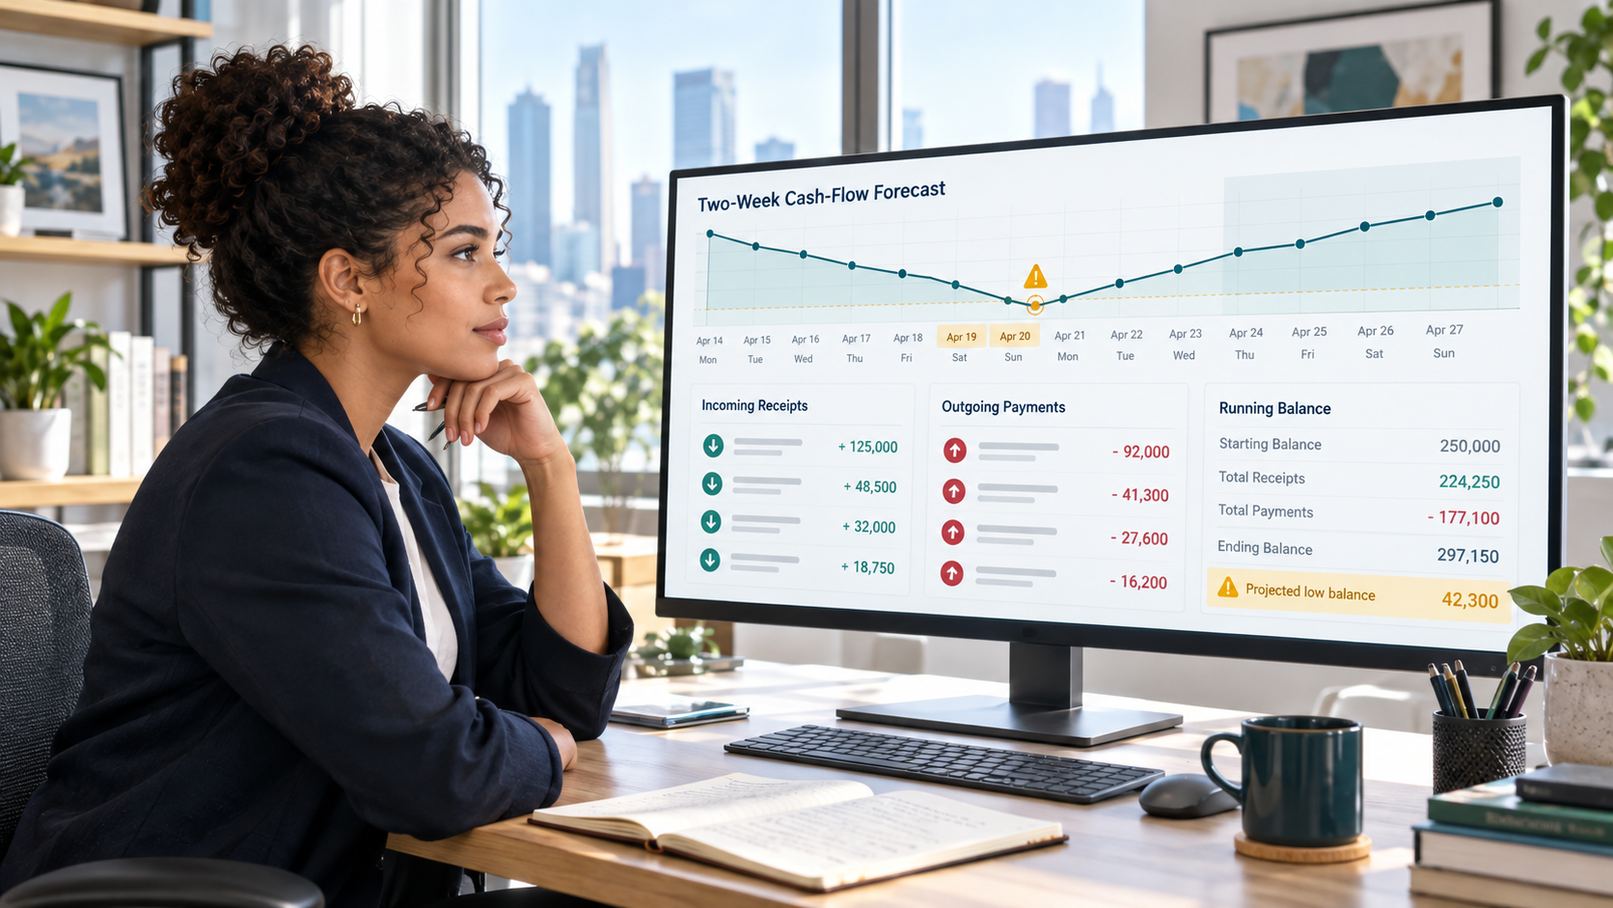
USE CASE 07 · LOOK AHEAD
Build a Cash-Flow Watchlist
A cash watchlist and reviewed email draft
C1382 • v2.1
84

Slide 85
USE CASE 07
From repetitive work to a finished outcome
BEFORE
AFTER
Receipts and payments sit in separate files
A cash watchlist and reviewed email draft
C1382 • v2.1 • Task automation with Claude Cowork
85

Slide 86
USE CASE 07
What Cowork receives
FILE
BRIEF
CHECK
Receivables
Payments
Cash assumptions
C1382 • v2.1 • Task automation with Claude Cowork
86

Slide 87
USE CASE 07
What Cowork does
1
2
3
Merge dates
Calculate balance
Draft alert
C1382 • v2.1 • Task automation with Claude Cowork
87

Slide 88
USE CASE 07
Build the request in five clear parts
OUTCOME
A cash watchlist and reviewed email draft
INPUT
Receivables, Payments
ACTION
Combine them into a 14-day running balance
CHECK
Low-balance day and top payments match the workbook
STOP
Pause before sending, scheduling or publishing
C1382 • v2.1 • Task automation with Claude Cowork
88

Slide 89
USE CASE 07
The task needs three simple capabilities
FIND & READ
BUILD
REVIEW OR DELIVER
Receivables
A cash watchlist and reviewed email draft
Low-balance day and top payments match the workbook
Cowork files
Spreadsheet skill
Outlook draft
C1382 • v2.1 • Task automation with Claude Cowork
89

Slide 90
USE CASE 07
Preview the finished output
WATCHLIST
Day 9: S$42k low point
Top payment: S$92k
Expected recovery: Day 11
Email remains a draft.
C1382 • v2.1 • Task automation with Claude Cowork
90

Slide 91
USE CASE 07
One human check before you use it
Low-balance day and top payments match the workbook
CHECK
If this does not match, correct the output and run the check again.
C1382 • v2.1 • Task automation with Claude Cowork
91

Slide 92
USE CASE 07
When this automation helps
WHO
WHEN
Treasury analyst
Before the daily cash call
C1382 • v2.1 • Task automation with Claude Cowork
92

Slide 93
USE CASE 07
What good looks like
1
2
3
14-day balance reconciles
Low point is visible
Email remains a draft
C1382 • v2.1 • Task automation with Claude Cowork
93

Slide 94
USE CASE 07
Try a useful variation
PERIOD
AUDIENCE
OUTPUT
30-day horizon
Currency view
Scenario stress test
C1382 • v2.1 • Task automation with Claude Cowork
94

Slide 95
LAB 07
Finish line
YOU ARE DONE WHEN
Low-balance day and top payments match the workbook
Save the skill for the next reporting period.
C1382 • v2.1 • Task automation with Claude Cowork
95

Slide 96

USE CASE 08 · REPEATABLE ROUTINE
Schedule a Weekly Finance Briefing
A controlled weekly routine ready for approval
C1382 • v2.1
96

Slide 97
USE CASE 08
From repetitive work to a finished outcome
BEFORE
AFTER
The same briefing is rebuilt every Monday
A controlled weekly routine ready for approval
C1382 • v2.1 • Task automation with Claude Cowork
97

Slide 98
USE CASE 08
What Cowork receives
FILE
BRIEF
CHECK
Approved workbook
Release checklist
Test recipient
C1382 • v2.1 • Task automation with Claude Cowork
98

Slide 99
USE CASE 08
What Cowork does
1
2
3
Run on demand
Check approval
Prepare delivery flow
C1382 • v2.1 • Task automation with Claude Cowork
99

Slide 100
USE CASE 08
Build the request in five clear parts
OUTCOME
A controlled weekly routine ready for approval
INPUT
Approved workbook, Release checklist
ACTION
Rehearse a scheduled task using only an approved workbook
CHECK
Draft stays on demand; unapproved workbook is rejected
STOP
Pause before sending, scheduling or publishing
C1382 • v2.1 • Task automation with Claude Cowork
100

Slide 101
USE CASE 08
The task needs three simple capabilities
FIND & READ
BUILD
REVIEW OR DELIVER
Approved workbook
A controlled weekly routine ready for approval
Draft stays on demand; unapproved workbook is rejected
Scheduled tasks
OneDrive
Outlook + Power Automate
C1382 • v2.1 • Task automation with Claude Cowork
101

Slide 102
USE CASE 08
Preview the finished output
APPROVED
WORKBOOK
COWORK
REVIEW
ONEDRIVE
FOLDER
POWER
AUTOMATE
OUTLOOK
TEST DRAFT
On demand rehearsal first • approval gate • test recipient • schedule remains disabled
C1382 • v2.1 • Task automation with Claude Cowork
102

Slide 103
USE CASE 08
One human check before you use it
Draft stays on demand; unapproved workbook is rejected
CHECK
If this does not match, correct the output and run the check again.
C1382 • v2.1 • Task automation with Claude Cowork
103

Slide 104
USE CASE 08
When this automation helps
WHO
WHEN
Finance operations lead
Before the Monday briefing
C1382 • v2.1 • Task automation with Claude Cowork
104

Slide 105
USE CASE 08
What good looks like
1
2
3
Only approved file enters flow
Test recipient is used
Schedule remains disabled
C1382 • v2.1 • Task automation with Claude Cowork
105

Slide 106
USE CASE 08
Try a useful variation
PERIOD
AUDIENCE
OUTPUT
Monthly pack
Different approver
Teams notification
C1382 • v2.1 • Task automation with Claude Cowork
106

Slide 107
LAB 08
Finish line
YOU ARE DONE WHEN
Draft stays on demand; unapproved workbook is rejected
Save the skill for the next reporting period.
C1382 • v2.1 • Task automation with Claude Cowork
107

Slide 108
TOPIC 03 RECAP
Monitor and Deliver
USE CASE 05
USE CASE 06
USE CASE 07
USE CASE 08
A tidy AP tracker ready for review
A reviewed workbook and one-page commentary
A cash watchlist and reviewed email draft
A controlled weekly routine ready for approval
C1382 • v2.1 • Task automation with Claude Cowork
108

Slide 109
YOUR AUTOMATION LIBRARY
Eight tasks, one repeatable pattern
1
2
3
4
Choose inputs
Ask clearly
Review output
Reuse the skill
C1382 • v2.1 • Task automation with Claude Cowork
109

Slide 110
NEXT MONDAY
Start with one task that already repeats
PICK
one folder and one outcome
RUN
on demand before scheduling
REVIEW
numbers, sources and recipient
C1382 • v2.1 • Task automation with Claude Cowork
110

Slide 111
KEEP CONTROL
Draft first · approve before action
FILES
FACTS
ACTIONS
Work from a copy
Check numbers and links
Review before send or schedule
C1382 • v2.1 • Task automation with Claude Cowork
111

Slide 112
COURSE COMPLETE
Your Cowork automation toolkit is ready
Eight scenarios · eight reusable skills · one clear review habit
C1382 • v2.1
112

